Slide 1
A Beautiful Mind
By Ron Howard

Slide 2
A Beautiful Mind is an unauthorized biography of Nobel Prize-winning economist and mathematician John Forbes Nash, Jr. by Sylvia Nasar, a New York Times economics correspondent.
1928-1995

Slide 3
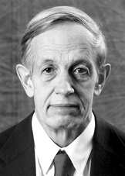
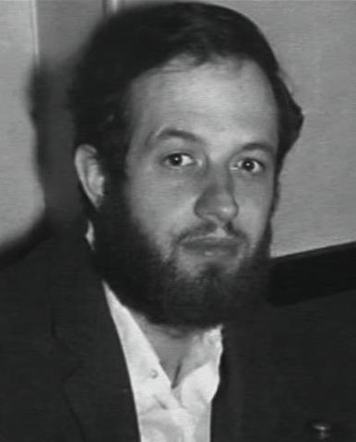
Born: 13 June 1928 in Bluefield, West Virginia, USA
John was described in 1958 as the:-
... most promising young mathematician in the world ...

Slide 4
Mise-en-scene:
The arrangement of scenery and properties to represent the place where a play or movie is enacted.
http://www.merriam-webster.com/netdict/mise-en-scene

Slide 5
What are the first images in the film (often while the credits are rolling), and what do they tell you.
Princeton University 1947
A Class Full of Men
A Teacher
Smoking
Wealthy School

Slide 6
Where and when is the film set?
USA
1947-1994
Nash was awarded the 1994 Nobel Prize in Economic Science for his work on game theory.
Princeton University

Slide 7
Do the objects and props in the setting, whether natural ones (like rivers and trees) or artificial ones (like paintings and buildings), have a special significance that relates to the characters or story?
Mental Hospital
Princeton University
John Nash’s House
The Classroom
University Dorm
John Nash’s Office
Princeton University makes John proud, he graduated from there, taught there, worked there. Also, he had his theory published through Princeton.

Slide 8
Sound and Music
Diegetic sound: Diegetic sound is any sound presented as originated from source within the film's world. Digetic sound can be either on screen or off screen depending on whatever its source is within the frame or outside the frame.
Non-diegetic sound: Sound whose source is neither visible on the screen nor has been implied to be present in the action: narrator's commentary sound effects which is added for the dramatic effect mood music Non-diegetic sound is represented as coming from the a source outside story space.

Slide 9
Find an example of Non-digetic sound? Why was this convention used? Be sure to describe the scene. (Outside the FILM)
Sound coming from outside the film, like the opening song.

Slide 10
Find an example of Diegetic sound. Why was this convention used? Be sure to describe the scene (In Film)
The scene where John Nash meets his New Roommate, a song is playing in the background and first it appears to be non-digetic sound, however the roommate walks in the room and flicks off the record player and the song stops abruptly.

Slide 11
Find a close-up shot. Explain why it was used; be sure to describe the scene.

Slide 12
High angle shot: The camera is placed higher than the subject, often suggesting a God's-eye view of helpless and vulnerable people.
Find an example of a High angle shot. Why this type of a shot used?
6:17- John Nash is up in his room looking down on a group of students playing football, they fade out and then Nash begins drawing on the window.

Slide 13
Identify an example of a Pan Shot:
After John has been released from the mental hospital Alisha has discovered Johns shed in the back of the house. The camera pans from one side of the shed to the other. All of Johns work is on the walls.
( 1:34)

Slide 14
Track Shot: a camera shot taken from a moving dolly. Identify an example of a track shot.
John has returned to Princeton University, he has an episode due to a misunderstanding in the library. He is fighting with William, as he walks away the camera moves on a track and follows John.

Slide 15
Editing: Dissolve
Time- 17.05 right after John Nash watched the professor receive recognition (Pens)
Can you find an example of dissolve in the film?

Slide 16
THEME:
In groups:
Complete the last page of the booklet.

Slide 17
Biography:
John Forbes Nash

