Slide 1
Related Issue 3
Economic Globalization
Chapter 11
Chapter 12
Chapter 13
Chapter 14
Chapter 15

Slide 2
Foundations of Economic Globalization
Economic globalization is the process of economies throughout the world growing more and more connected.
Several key events led to the development of economic globalization as we know it today:
Bretton Woods Agreement 1944
Creation of the World Bank 1944
Development of the International Monetary Fund 1944
End of the Cold War 1989
Technological development and communications

Slide 3
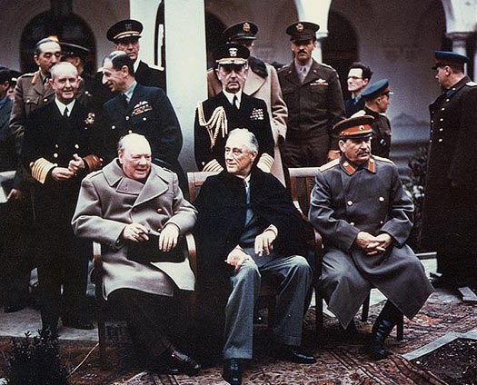
Bretton Woods Agreement
Countries that fought against Germany, Italy and Japan in WWII, were known as the allies.

Slide 4
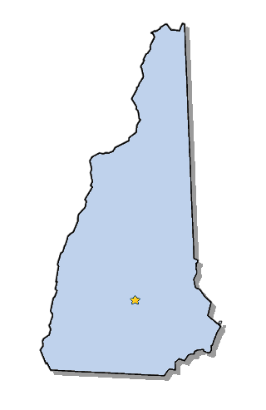
Bretton Woods Agreement
Towards the end of the war, these countries became concerned about how they would rebuild their economies.
Representatives from 44 countries, including Canada, met in Bretton Woods New Hampshire to discuss this issue.
They all signed the Bretton Woods Agreement – established a system of rules and institutions for the global economy that is still with us today.
The World Bank – International Monetary Fund – the General Agreement on Tariffs and Trade (which later became the World Trade Organization) were all established at this conference.

Slide 5
World Bank
The world bank was supposed to help rebuild countries devastated by the war. It provided billions of dollars in financial aid to Western European countries following the war.
It still provided loans to member countries in financial difficulty.
In order to get these loans countries need to meet certain standards
They need to reduce government debt and corruption
They are required to have a Free-market economy

Slide 6
International Monetary Fund
The IMF was created to work together with the world bank to bring stability to international monetary affairs and to help expand global trade.
While the World Bank is in charge of long term financial assistance for countries in need, the IMF is in charge of monitoring exchange rates and providing short term financial assistance. They are both Agencies of the United Nations.

Slide 7
The End of the Cold War
The end of the Cold War in 1989 pushed the economy forward.
The cold war began in 1946 after the end of WWII. For more than 40 years the forces of capitalism and free-market economies went against communism and centrally planned economies.
The Cold War was mostly an economic struggle between capitalist and communist.
By the end of the Cold War people were using computers, watching international events on television sets and doing business around the world.
From the 1990’s on the forces of globalization and capitalism merged to expand the forces of economic globalization.

Slide 8
Impact of Technology on Communications and Economic Globalization
Bretton woods and the end of the cold war pushed globalization ahead.
Throughout the Cold War, technological developments were changing the world.

Slide 9
F.A. Hayek
Supporter of Classical Liberalism
Hayek is an economist and major political thinker of the twentieth century. Hayek's account of how changing prices can communicate information which enables individuals to coordinate their plans is widely regarded as an important achievement in the economy. (Stock markets, trading, etc.)
“There is no figure who had more of an influence, no person had more of an influence on the intellectuals behind the Iron Curtain than Friedrich Hayek. His books were translated and published by the underground and black market editions, read widely, and undoubtedly influenced the climate of opinion that ultimately brought about the collapse of the Soviet Union.”
—Milton Friedman (Hoover Institution)

Slide 10
F.A. Hayek (Frederick von Hayek)

Slide 11
Does the IMF help countries?
What Critics Say | What Supporters Say
The IMF sometimes provides loans that support military dictators friendly to American and European corporations | The IMF is simply a funding agency with little power to influence governments
The IMF often requires governments asking for loans to reduce debt by increasing taxes and cutting social programs, thus hurting people in need | The IMF goal is to advise and provide loans to countries, not to make social changes in the world
The IMF does not actively promote democracy, human rights or labour rights | The IMF helps countries build economic stability, which is critical for countries trying to build a strong democracy
The IMF is controlled by the United States and other more developed countries

Slide 12
Trade
Trade Liberalization is the process of reducing barriers to trade.
When one country has a product which another country wants trade needs to take place.
One country imports the product and purchases it from another country. Usually there are ‘barriers’ or “tariff’s” that are placed upon a product or good that is imported or exported.

Slide 13
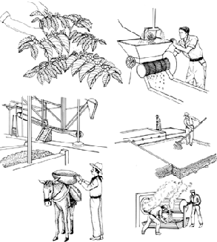
Coffee Bean Processing

Slide 14
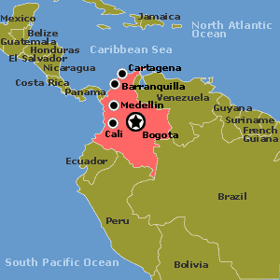
Coffee
Shipped to America
Grown in Colombia, South America
Manufactured and processed
Purchased by Americans

Slide 15
Free Trade
Trade between countries with relatively few restrictions
Trading Blocs – A group of countries working together to give one another better trading terms
Tariff – a tax on imported goods or services meant to reduce competition with domestic goods or services.

Slide 16
NAFTA – Free Trade Agreements
Softwood Lumber agreement with the USA (See page 187 of your textbook)
Read Pages 188 and 189 of your textbook
Create your own chart
Positives of Free Trade | Negatives of Free Trade

Slide 17
World Trade Organization (GATT)
Was created in 1947 by 23 countries that believed free trade among member countries would encourage peaceful relations.
In 1995 GATT (General Agreement on Tariffs and Trade) became the World Trade Organization
G8 – The Group of 8
Includes the 8 most developed countries with the strongest economies.
G8 is not a formal organization like the WTO, but it is able to influence official global institutions.
G8 countries have 50% of the vote in the World Bank and the IMF, they also have a significant impact on the policies of the WTO

Slide 18
Case Study Page 190 and page 201
Aboriginal peoples and FTA Questions: pg. 190
1. In what ways might aboriginal peoples feel that free trade and economic globalization have not contributed to their economic prosperity?
2. What might be some different understandings of free trade among aboriginal peoples?
Indigenous peoples and the FTAA Questions Pg. 201
3. A strong bond exists between indigenous peoples economies and nature. How might the world view of indigenous peoples in South America influence the ideas that the Hemispheric Social Alliance is developing?

Slide 19
Do Trade Agreements benefit all people?
Read page 202 and discern your answer from the textbook.

