Slide 1
Exploring the Roots of Liberalism
So 2.4, 2.5
Chapter 4

Slide 2
To what extent have various ideas and events shaped Liberalism over time?
Aboriginal contributions to Liberalism
Liberal thought in Western societies

Slide 3
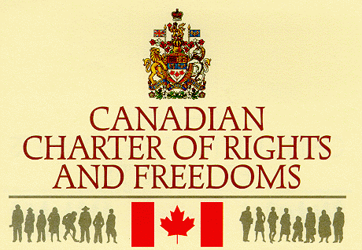
Liberalism has changed....
Like ideologies, liberalism has changed in response to historical conditions, yet some key values have remained:
Rights and freedoms of the individual
People have the right to decide who leads them.

Slide 4
In what ways have Aboriginal peoples contributed to the early development of liberalism? Specific outcome 2.4

Slide 5
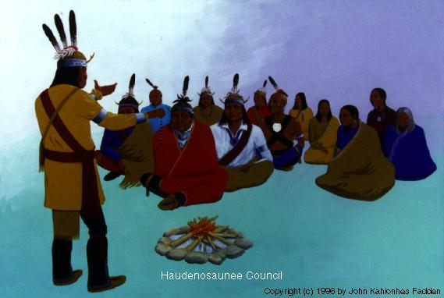
The Haudenosaunee Confederacy
Also know as the Iroquois Confederacy
Formed between 1400 and 1600
Often referred to as one of the first and longest lasting participatory democracies in the world.

Slide 6
The Haudenosaunee Confederacy
Consisted of 5 different nations:
The Mohawk
The Oneida
The Onondaga
The Cayuga
The Seneca
Each nation had its own council and chief, who were selected by the Clan Mother.
All nations of the Haudenosaunee share a common goal....to live in harmony.

Slide 7
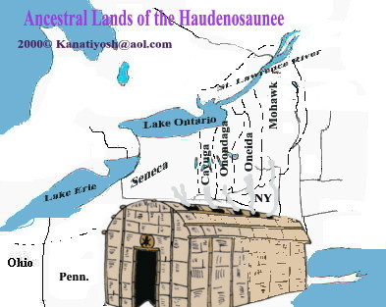
Location of the Haudenosaunee Confederacy

Slide 8
Absolute Monarchy vs Democracy
At the time of first contact between Europeans and First Nations peoples, most European societies were absolute monarchies- power and the right to rule were exclusive to royalty, nobility and the church.

Slide 9
The Great Law of Peace
The constitution of the Haudenosaunee Confederacy, which was passed orally for generations. It outlined:
The path to harmony and unity between warring nations
Divided power between different levels of gov’t
Provided for equal participation of people in the gov’t – including women.
Guaranteed rights and freedom – freedom of speech, religion.

Slide 10
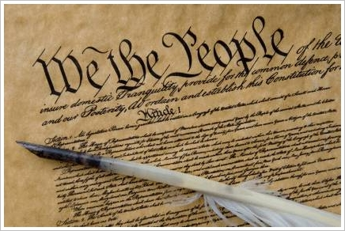
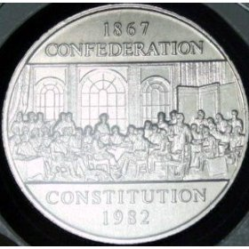
American and Canadian Influences...
Some historians believe the ideas and values in the Great Law of Peace may have influenced the American Constitution in 1787 and the Canadian Constitution 80 years later.

Slide 11
Relationship between the values of liberalism and origins of liberal thought... Adam Smith, John Stuart Mill
Specific outcome 2.5

Slide 12
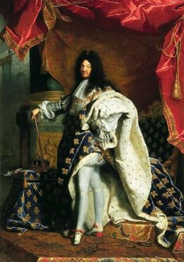
Western European Origins of Liberalism
Liberal ideas of today came from Europe.
Absolute monarchies prevailed in the 1700’s
The King (or queen) had complete power over the government.

Slide 13
Challenges to Absolute Monarchies
Mid 1700’s – many Europeans began to challenge the absolute monarchies and propose changes
Early 1800’s the term ‘liberal’ was first used to describe those who supported the freedom or liberty of the individual.

Slide 14
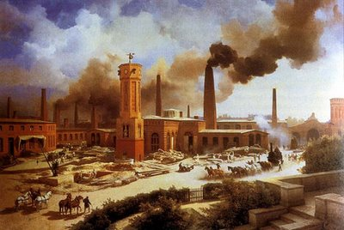
Liberal Ideas on Economic Systems
During the 1700-1800’s, the Industrial Revolution challenged almost everything about the way people lived.
The Industrial Revolution got people thinking differently about how an economy should operate.

Slide 15
Mercantilism
Europe was based on Mercantilism prior to the Industrial Revolution.
A country should export more goods than it imports
Accumulate wealth in gold and silver
Protect the economy by taxing and setting quotas on imports
Gov’t exercised much control over the economy (corporations, regulation of production)
Government leaders therefore lived in luxury and workers lived in poor conditions.

Slide 16
Class System in Britain – 1800’s
Tended to keep people in the same social class as their parents, thus limiting their
potential for economic advancement.
Upper Class
(Wealthy landowning aristocrats (nobility)
Middle Class
(Business owners, merchants, bankers, professionals)
Working Class
(Manual labourers – farm workers, factory workers, domestic servants, tradespeople)

Slide 17
Adam Smith and the Wealth of Nations
Challenged the key ideas of mercantilism in his book ‘The Wealth of Nations’
Criticisms of Mercantilism:
- unequal distribution of wealth throughout society.
-government leaders usually played favourites with business owners and landowners. Often monopolies formed (exclusive right to extract or produce goods)
- lack of competition

Slide 18
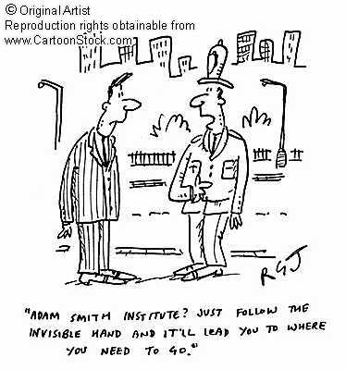
Adam Smith and the Wealth of Nations
Smith proposed that the individual (or the company’s) pursuit of self-interest is guided by an ‘invisible hand’ to unintentionally improve the prosperity and well-being of society as a whole.
(more jobs)

Slide 19
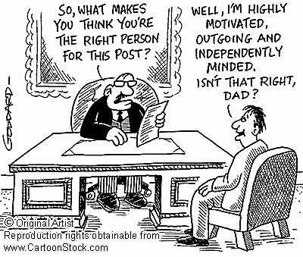
Adam Smith believed in...
Limited gov’t involvement
Meritocracy – type of economic system in which individuals are rewarded based on their abilities and hard work.
Laissez-faire

Slide 20
Mercantilism - Capitalism
Economic Liberalism was evolving from mercantilism.
Consumers and producers having the individual freedom to make economic choices for themselves is known as CAPITALISM

Slide 21
Mercantilism | Capitalism
Government regulation in the economy | Little of no government regulation of business
Monopolies | Competition
Accumulation of wealth by a few people in society | Distribution of wealth across a wider range of society

Slide 22
Classical Liberalism
Was based on the writings of Smith and philosophers of the 1600’s (Locke)
Believed that the rights and freedoms of individuals as the most important part of society.

Slide 23
Liberal Ideas on Political Systems
Liberal democracies are based on:
-the equality of all citizens
-free elections
-multiple political parties
-decisions made by a elected legislature
-independent judiciary
-individualism

Slide 24
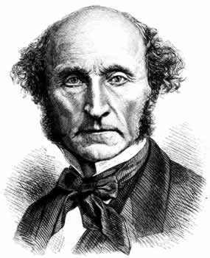
John Stuart Mill
Wrote On Liberty – 1859
Wrote on the benefits of allowing as many individual rights as possible by limiting the role of gov’t
Believed in individual freedom
and that every individual
should be as free as possible
so long as an individual’s
actions don’t harm anyone
else.

Slide 25
The Beginnings of Modern Liberalism
Modern liberalism developed over time to address concerns with the inequality created by laissez-faire capitalist society.

Slide 26
Ideological Values
Collectivism
Individualism
Modern Liberalism | Classical Liberalism
Interested in creating equality of opportunity for all individuals | Interested in protecting the freedoms of individuals in economic affairs
Freedoms & rights favour the individual | Maximum rights and freedoms for certain individuals
Gov’t intervention to ensure vulnerable (sick, elderly, unemployed) are cared for | Gov’t rules, regulations and social programs are kept to a minimum – act on your own behalf

